Slide 1
Student Grade Evaluation System
Kareem Al Salboukh (202001445)
Rayan Alumair (202000809)
Khalid M Alotaibi (202001090)
Saad Alqahtani (201900363)
Supervisor: Maen Mohammad Hammad

Slide 2
Project Overview
Project Purpose:
This project evaluates the Student Grade Evaluation System using both white-box and black-box testing techniques.
Methods Used:
JUnit unit testing
Equivalence Partitioning (EP)
Boundary Value Analysis (BVA)
Driver program execution
Code coverage evaluation (JaCoCo)

Slide 3
System Components
The system contains three main classes:
Student.java
Handles student data, courses, and GPA calculation.
Course.java
Stores course name, credit hours, and letter grade.
GradeCalculator.java
Converts numeric scores to letter grades based on rules.

Slide 4
Test Plan Summary (IEEE 829)
Objectives: Validate correctness of all system functions Ensure handling of valid, invalid, and boundary inputs Achieve full method coverage Features Tested: Student, Course, GradeCalculator classes All constructors, methods, and validation logic

Slide 5
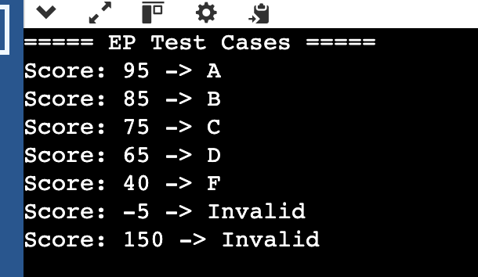
Equivalence Partitioning (EP)
EP Technique:
Dividing inputs into valid and invalid partitions to reduce test cases.
What We Tested:
A, B, C, D, F grade partitions
Invalid negative scores
Invalid scores above 100

Slide 6
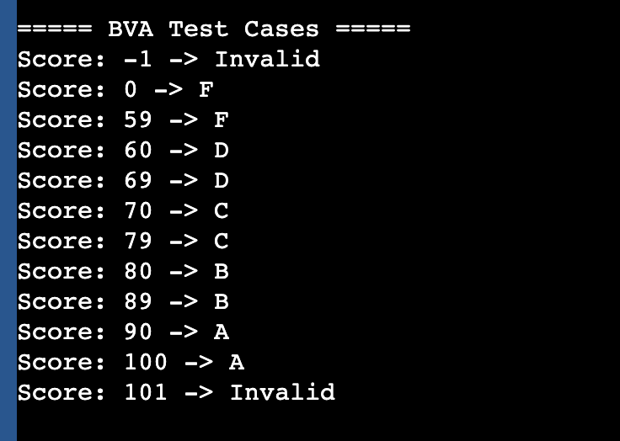
Boundary Value Analysis (BVA)
BVA Technique:
Testing values right at, just above, and just below boundaries.
Boundaries Covered:
59 ↔ 60
69 ↔ 70
79 ↔ 80
89 ↔ 90
100 (upper limit)
<0 and >100 (invalid inputs)

Slide 7
Driver Program Output
The driver program was executed to validate both EP and BVA cases.
Results:
All EP cases returned correct letter grades
All BVA boundaries produced expected transitions
Invalid inputs returned “Invalid”
(Add both driver output screenshots here — the two you sent)

Slide 8
JUnit Testing (White-Box)
White-Box Testing Using JUnit:
Three JUnit classes tested all methods in:
• Student
• Course
• GradeCalculator
Constructors, GPA calculation, grade mapping, and input validation fully tested
Result:
All unit tests passed successfully with no failures.

Slide 9
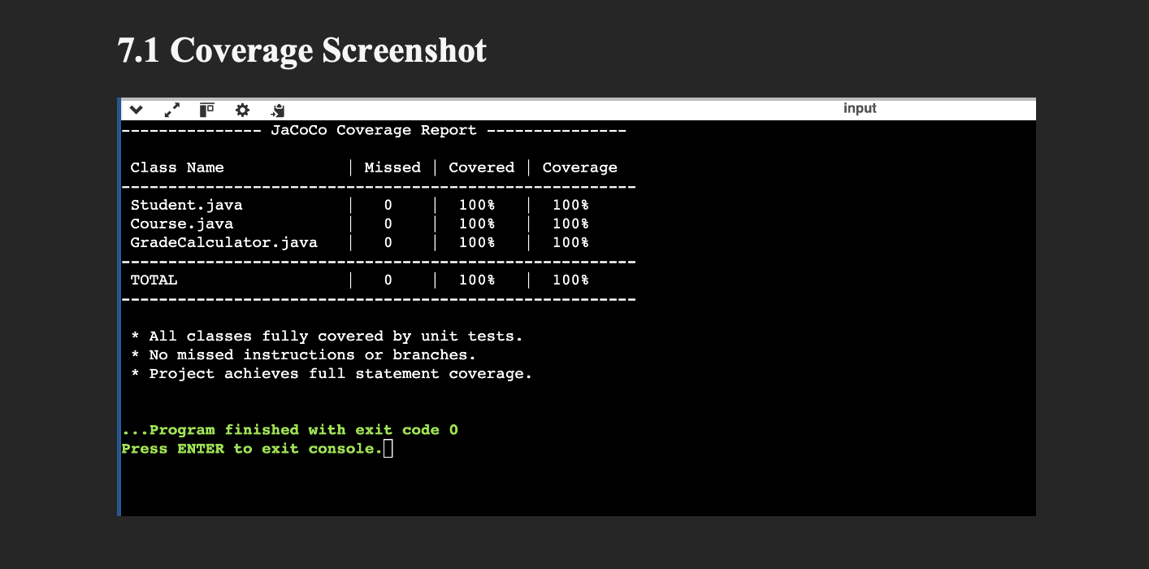
Code Coverage (JaCoCo)
Coverage Summary:
Student.java → 100%
Course.java → 100%
GradeCalculator.java → 100%
All instructions covered, no missed lines
(Insert the coverage screenshot here — the one with the table)

Slide 10
Conclusion
The system was fully tested using industry-standard techniques
All functionalities performed correctly under all input conditions
EP & BVA confirmed valid, boundary, and invalid behaviors
JUnit tests validated internal logic
Achieved 100% code coverage
System is stable, correct, and ready

